Slide 1
Topology for Data Science: Morse Theory and Application
Colleen M. Farrelly

Slide 2
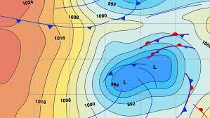
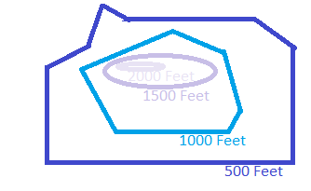
Level Sets in Everyday Life
Front maps partition weather patterns by areas of the same pressure (isobars).
Elevation maps partition land areas by height above/below sea level.

Slide 3
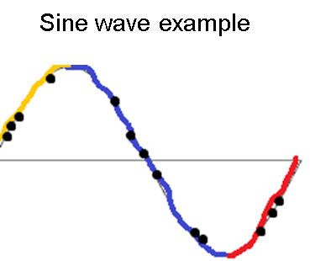
Level Sets of Functions
Continuous functions have defined local and global peaks, valleys, and passes.
Define height “slices” to partition function.
Akin to a cheese grater scraping off layers of a cheese block.
In the example, the blue lines slice a sine wave into pieces of similar height.
Function on discrete date (points) can be partitioned into level sets, too.

Slide 4
Level Sets to Critical Points
Continuous functions:
Can be decomposed with level sets.
Contain local optima (critical points).
Maxima (peaks)
Minima (valleys)
Saddle points (inflections/height change)
Continuous functions can live in higher-dimensional spaces with more complicated critical points.

Slide 5
Degenerate and Non-Degenerate Optima
Morse functions have stable and isolated local optima (non-degenerate critical points).
Related to 1st and 2nd derivatives of function.
Don’t change with small shifts to the function.
Technically, related to Hessian being defined/undefined at the critical point.
Reflects neighborhood behavior around the critical point.
Non-degenerate critical points have defined behavior in the critical point’s neighborhood.
Degenerate points have undefined behavior near the critical point.
f’=0
f’’(x)<0
f’’(x)=0
f’’(x)>0
f’=0

Slide 6
Morse Function Definition
None of the function’s critical points are degenerate.
None of the critical points share the same value.
These properties allow a map between a function’s critical point values to a space of level sets (left).
All critical values map to values in the level set collection.
Function can be plotted nicely to summarize its peaks, valleys, and in-between spaces.
1
Critical Point Map
0
Level Set
-1

Slide 7
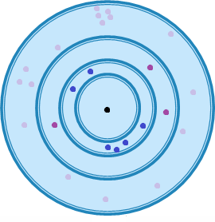
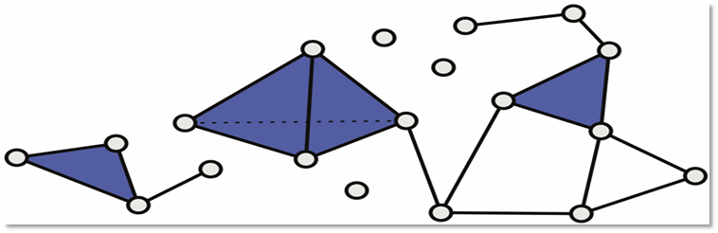
Discrete Extensions to Data Analysis
2-d neighborhoods are defined by Euclidean distance.
Points within a given circle are mutually connected, forming a simplex.
Morse functions can be extended to discrete spaces.
Data lives in a discrete point cloud.
Topological spaces, called simplicial complexes, can be built from these.
Several algorithms exist to connect points to each other via shared neighborhoods.
Vietoris-Rips complexes are built from connecting points with d distance from each other.
Any metric distance can be used.
Process turns data into a topological space upon which a Morse function can be defined.
Example simplicial complex

Slide 8
Morse-Smale Clustering
Partition space between minima and maxima of function by flow.
Example:
The truncated sine wave shown has 2 minima and 2 maxima shown (dots).
Pieces between local minima and maxima define regions of the function.
Yellow
Blue
Red
Higher-dimensional spaces can be simplified by this partitioning.
Can be used to cluster data.
Subgroups can then be compared across characteristics using statistical tests (t-test, Chi square…).
Cluster 1
Cluster 2
Cluster 3

Slide 9



Intuitive 2-Dimensional Example
Imagine a soccer player kicking a ball on the ground of a hilly field.
The high and low points determine where the ball will come to rest.
These paths of the ball define which parts of the field share common hills and valleys.
These paths are actually gradient paths defined by height on the field’s topological space.
The spaces they define are the Morse-Smale complex of the field, partitioning it into different regions (clusters).
Algorithms that compute Morse-Smale complexes typically follow this intuition.

Slide 10
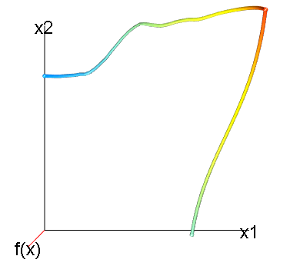
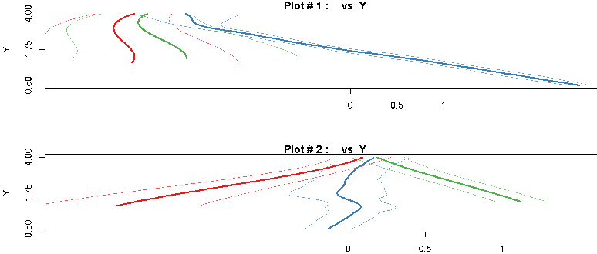
Morse-Smale Regression
Type of piece-wise regression.
Fit regression model to partitions found by Morse-Smale decompositions of a space given a Morse function.
Regression models include:
Linear and generalized linear models
Machine learning models
Random forest
Elastic net
Boosted regression
Neural/deep networks
Can examine group-wise differences in regression models.
Example: 2 groups, 3 predictors

Slide 11
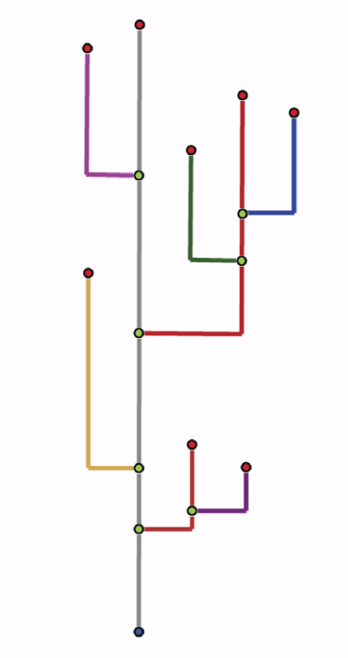
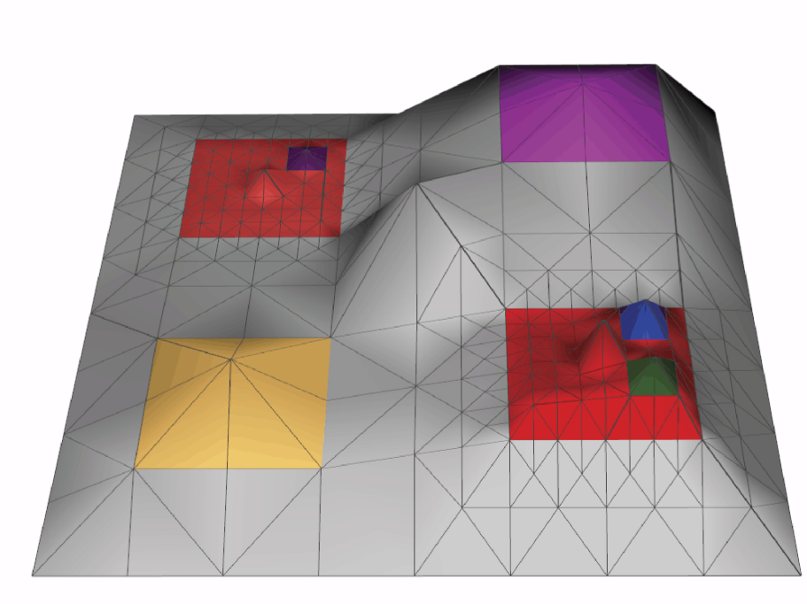
Reeb Graphs
Track evolution of level sets through critical points of a Morse function.
Partition space according to a function (left by height).
Plot critical points entering model.
Track until they are subsumed into another partition.
Useful in image analytics and shape comparison.

Slide 12
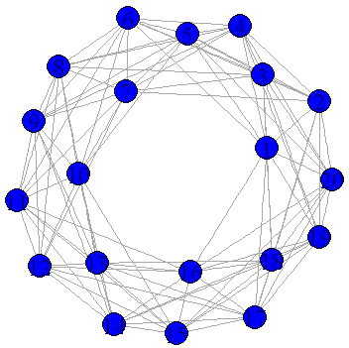
Persistent Homology
Filtration of simplicial complexes built from data
Iterative changing of lens with which to examine data (neighborhood size…)
Topological features (critical points) appear and disappear as the lens changes.
Creates a nested sequence of features with underlying algebraic properties, called a homology sequence:
Hom₁⊂Hom₂⊂Hom₃⊂Hom₄
Persistence gives length of feature existence in homology sequence.
Many plots (left) exist to summarize this information, and special statistical tools can compare datasets/topological spaces.
Filtration defines an MRI-type examination of data’s topological characteristics and evolution of critical points.

Slide 13
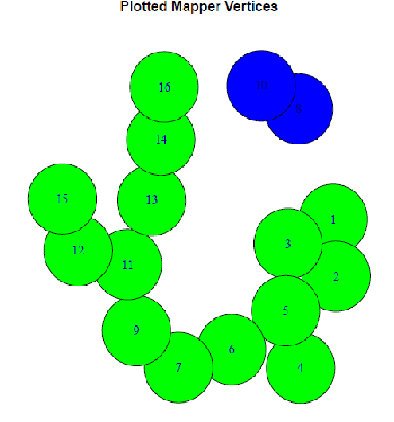
Mapper Algorithm
Generalizes Reeb graphs to track connected components through covers/nerves of a space with a defined Morse function.
Basic steps:
Define distance metric on data
Define filtration function (Morse function)
Linear, density-based, curvature-based…
Slice multidimensional dataset with that function
Examine function behavior across slice (level set)
Cluster by connected components of cover
Plot clusters by overlap of points across covers
Response gradations
Outliers

Slide 14
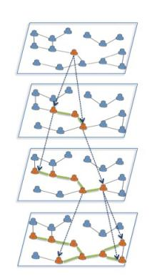
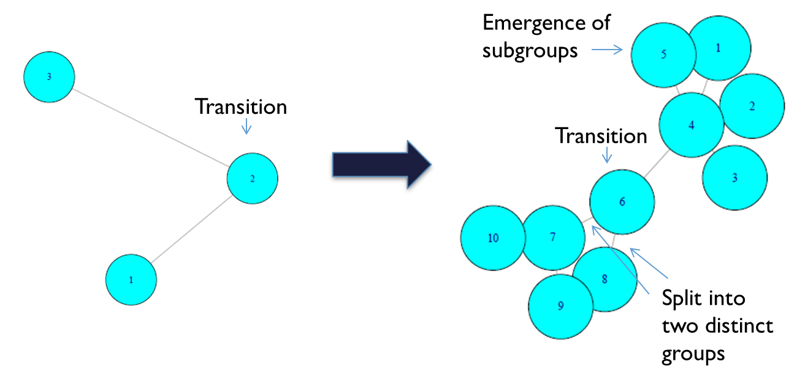
Multiscale Mapper Methods
1st Scale
2nd Scale
Psychometric test example: verbal vs. math ability
Scale change
Mapper clusters change with parameter scale change (unstable solutions).
Filtrations at multiple resolution settings to create stability (see above example).
Creates hierarchy of Reeb graphs (mapper clusters) from each slice.
Analyze across slices to gain deeper insight underlying data structures.

Slide 15
Conclusion
Morse functions underlie several methods used in modern data analysis.
Understanding the theory and application can facilitate use on new data problems, as well as development of new tools based on these methods.
Combined with statistics and machine learning, these methods can create power analytics pipelines yielding more insight than individual

Slide 16
Good References
Carlsson, G. (2009). Topology and data. Bulletin of the American Mathematical Society, 46(2), 255-308.
Gerber, S., Rübel, O., Bremer, P. T., Pascucci, V., & Whitaker, R. T. (2013). Morse–smale regression. Journal of Computational and Graphical Statistics, 22(1), 193-214.
Edelsbrunner, H., & Harer, J. (2008). Persistent homology-a survey. Contemporary mathematics, 453, 257-282.
Forman, R. (2002). A user’s guide to discrete Morse theory. Sém. Lothar. Combin, 48, 35pp.
Carr, H., Garth, C., & Weinkauf, T. (Eds.). (2017). Topological Methods in Data Analysis and Visualization IV: Theory, Algorithms, and Applications. Springer.
Di Fabio, B., & Landi, C. (2016). The edit distance for Reeb graphs of surfaces. Discrete & Computational Geometry, 55(2), 423-461.

